Slide 1


QUERY-BASED SUMMARIZATION
Manaswini Nagaraj, Juhi Paliwal, Viramya Shah

Slide 2
Text Summarization
Technique for generating concise summary with useful information and maintaining the overall meaning of the original data
Extractive
Relevant words pulled out from the original text
Abstractive
Generating sentences describing the context of original text

Slide 3
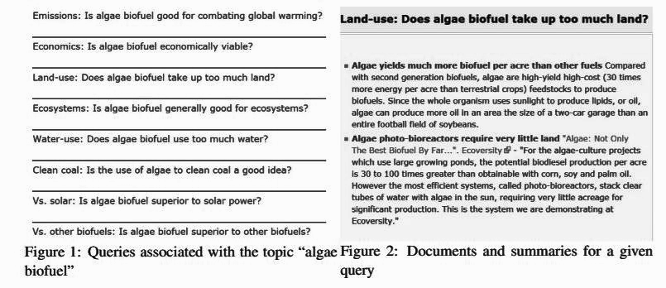
DATASET
A collection of corpus on various debate topics collected from Debatepedia
663 debates, with documents which all have at least one query
Debate = {query,document,summary}
Avg queries/debate = 5
Avg documents/query = 4
The average word count per:
Document | Summary | Query
66 | 11 | 10
Notes:
, an encyclopedia for arguments and quotes on various debate topics.
The documents cover a set of 53 overlapping topics. Politics, Environment, Morality, Religion etc.

Slide 4
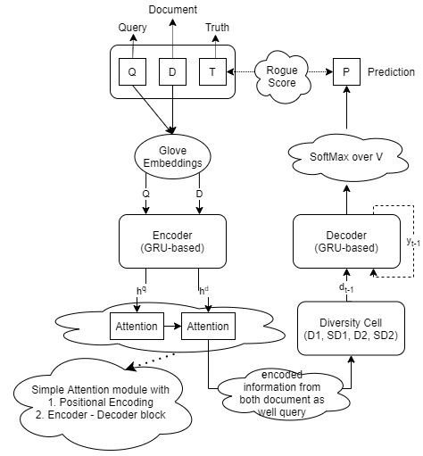
MODEL TECHNICALITIES

Slide 5
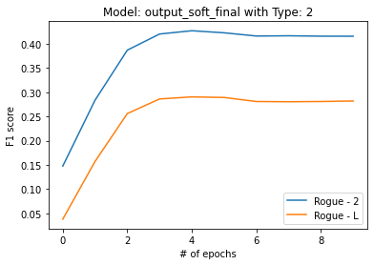
RESULTS
RESULT

Slide 6
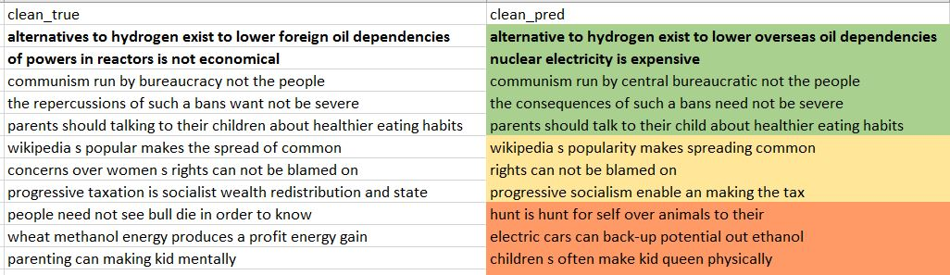
PREDICTED SUMMARY

Slide 7
ROADBLOCKS AND SOLUTION
Noisy data
Overfitting model
Triplet dataset
(q, d, s)
Repetition of words due to same contextual vector
Diversity cell introduced
Ortho, soft ortho and lstm-soft lstm
Working with sd2
Might be because context is not remembered, so using lstm (d2 and sd2)

Slide 8

Conclusion:
A Query-based Abstractive Summarization model
The model is a diversification mechanism based on successive orthogonalization.
Provides diverse context vectors at successive time steps
Pays attention to words repeatedly if need be later in the summary.
Adding an attention mechanism on the query string gives best summaries.
Future Scope:
A Context-based Abstractive Summarization model
Context = Single word/ phrase/sentence/query
Opinion generation

Slide 9

Thank you!
Mask Up & Stay Safe!

